Slide 1
Year 12 transition work
A level – fashion and textiles aqa

Slide 2
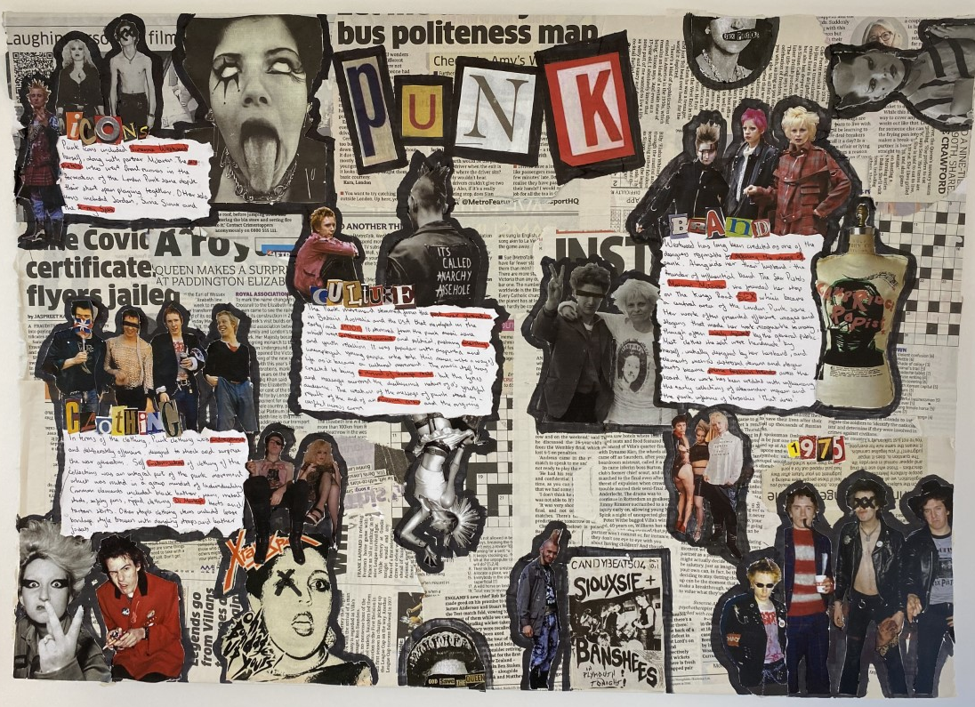
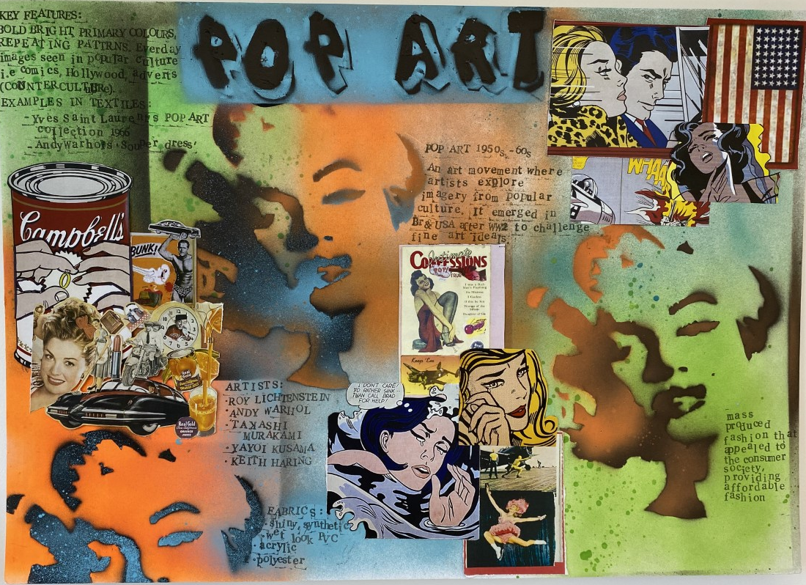
Research: Design movements
TASK 1: RESEARCH BOARD
Choose a design movement-
Art Nouveau
Art Deco
Pop art
Minimalism
Punk
Create an A3 research board on the design movement-
You must include..
Clear title
Images/sketches
At least 10 key facts that link to fashion trends/styles
Make the research board creative and visually appealing

Slide 3
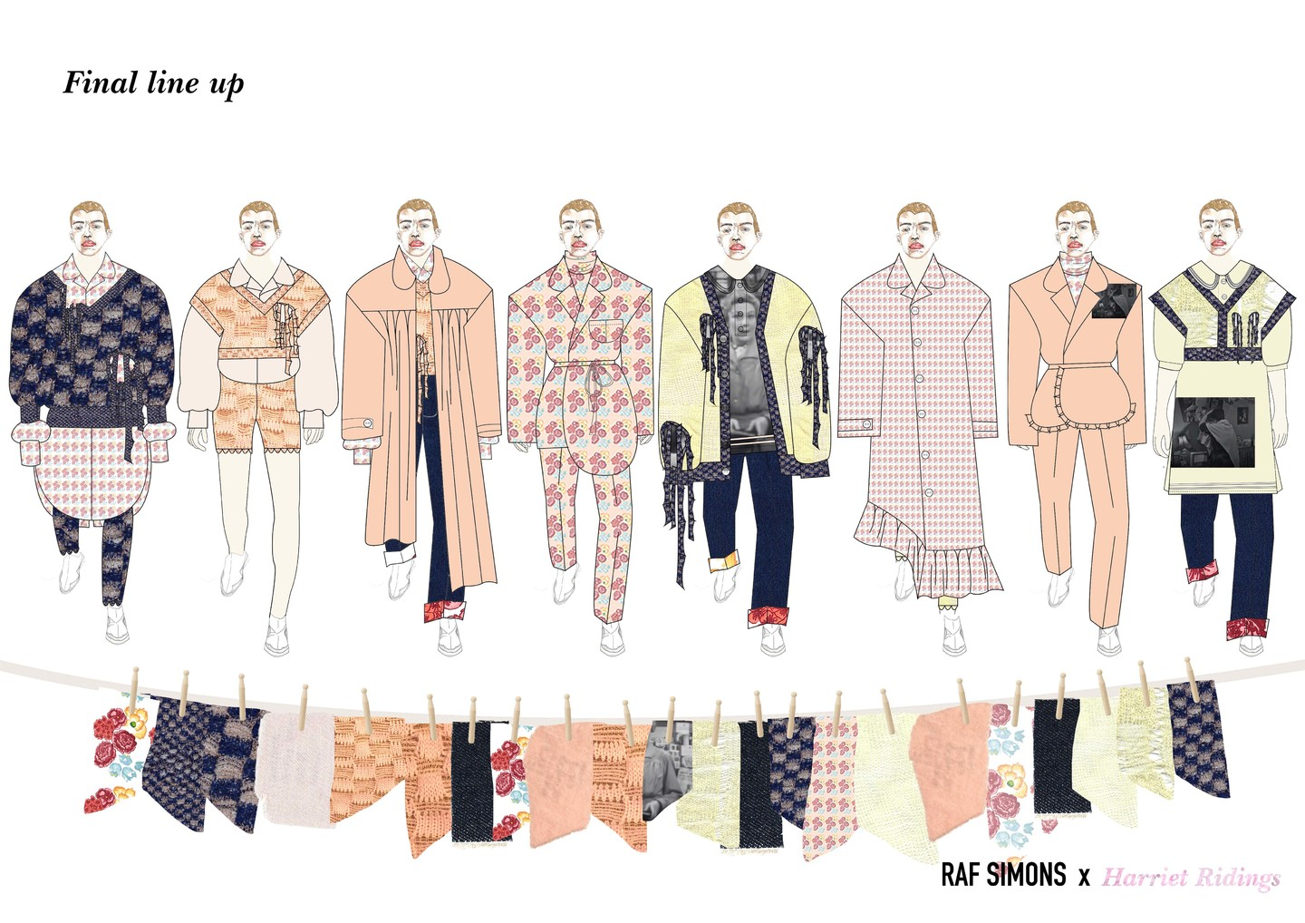
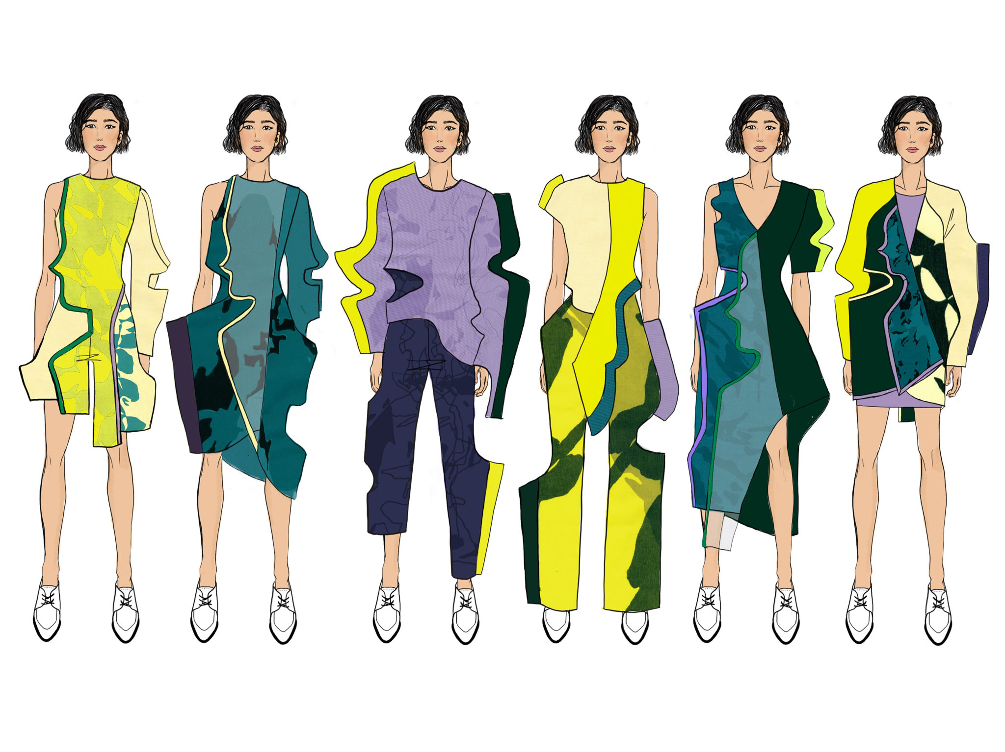
Design task:
TASK 2: ILLUSTRATED 6 OUTFIT LINE UP
You now need to create an illustrated 6 outfit lineup based on your chosen design movement.
You line up must...
Be presented on A3 paper
(stick two A4's together if you don’t have A3)
Be in colour
Use mixed media – collage/paints/pens/fine liner
Must be 6 full outfits including shoes and accessories

Slide 4
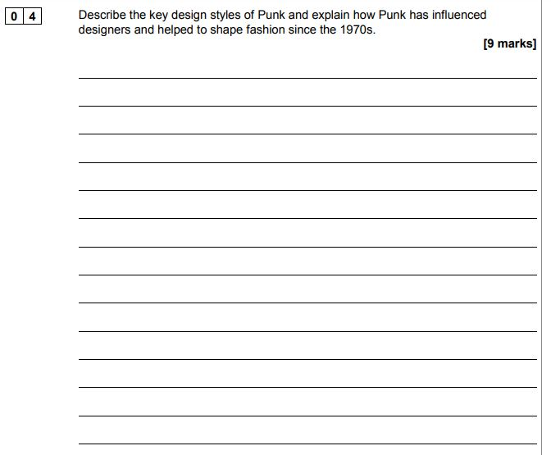
Exam question- Punk

Slide 5
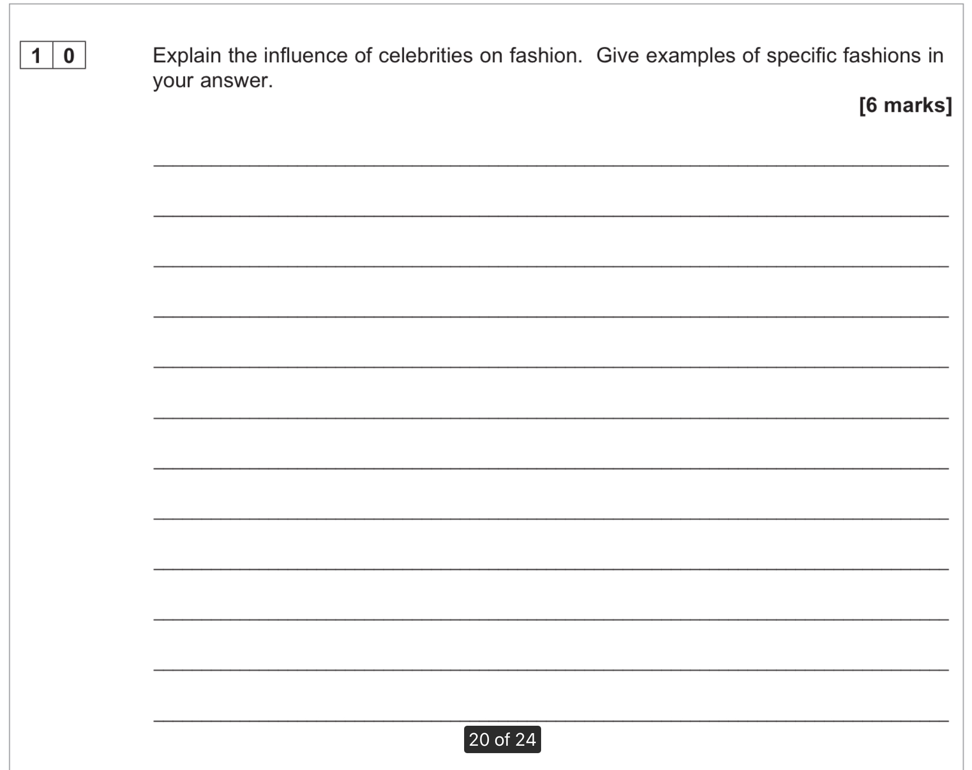
Exam question- fashion influences

