Slide 1
Year 12 transition work
A level – DT Product design Edexcel

Slide 2
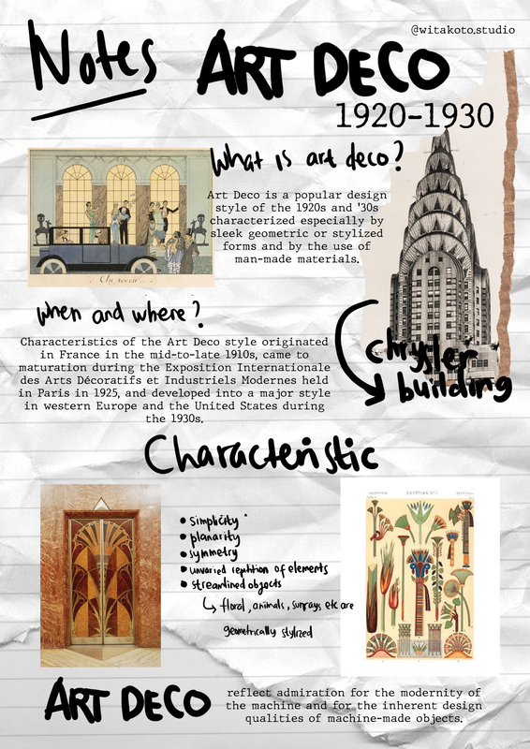
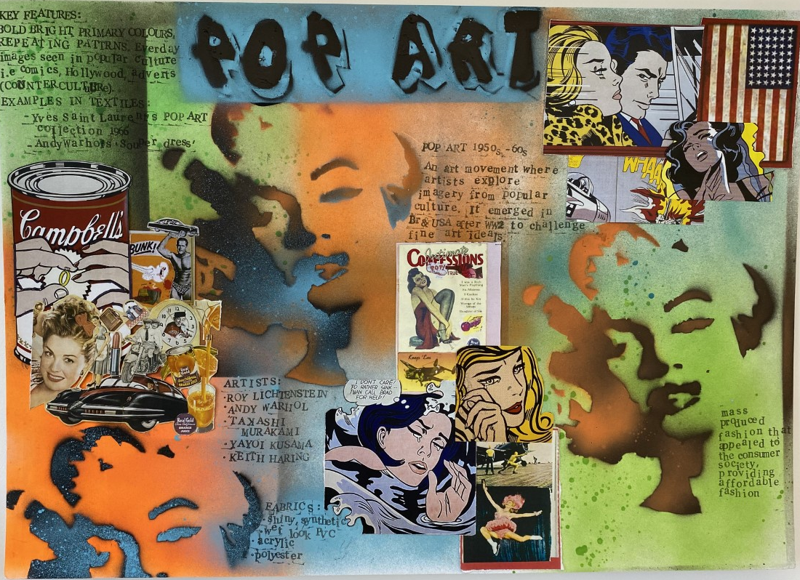
Research: Design movements
TASK 1: RESEARCH BOARD
Choose a design movement-
Art Nouveau
Art Deco
Pop Art
Bauhaus
Streamline
Create an A3 research board on the design movement-
You must include..
Clear title
Images/sketches of products /Architecture linked to chosen art movement.
At least 5 key facts that link to Art movement, artists/ designers, key dates, shapes, colours and general facts

Slide 3
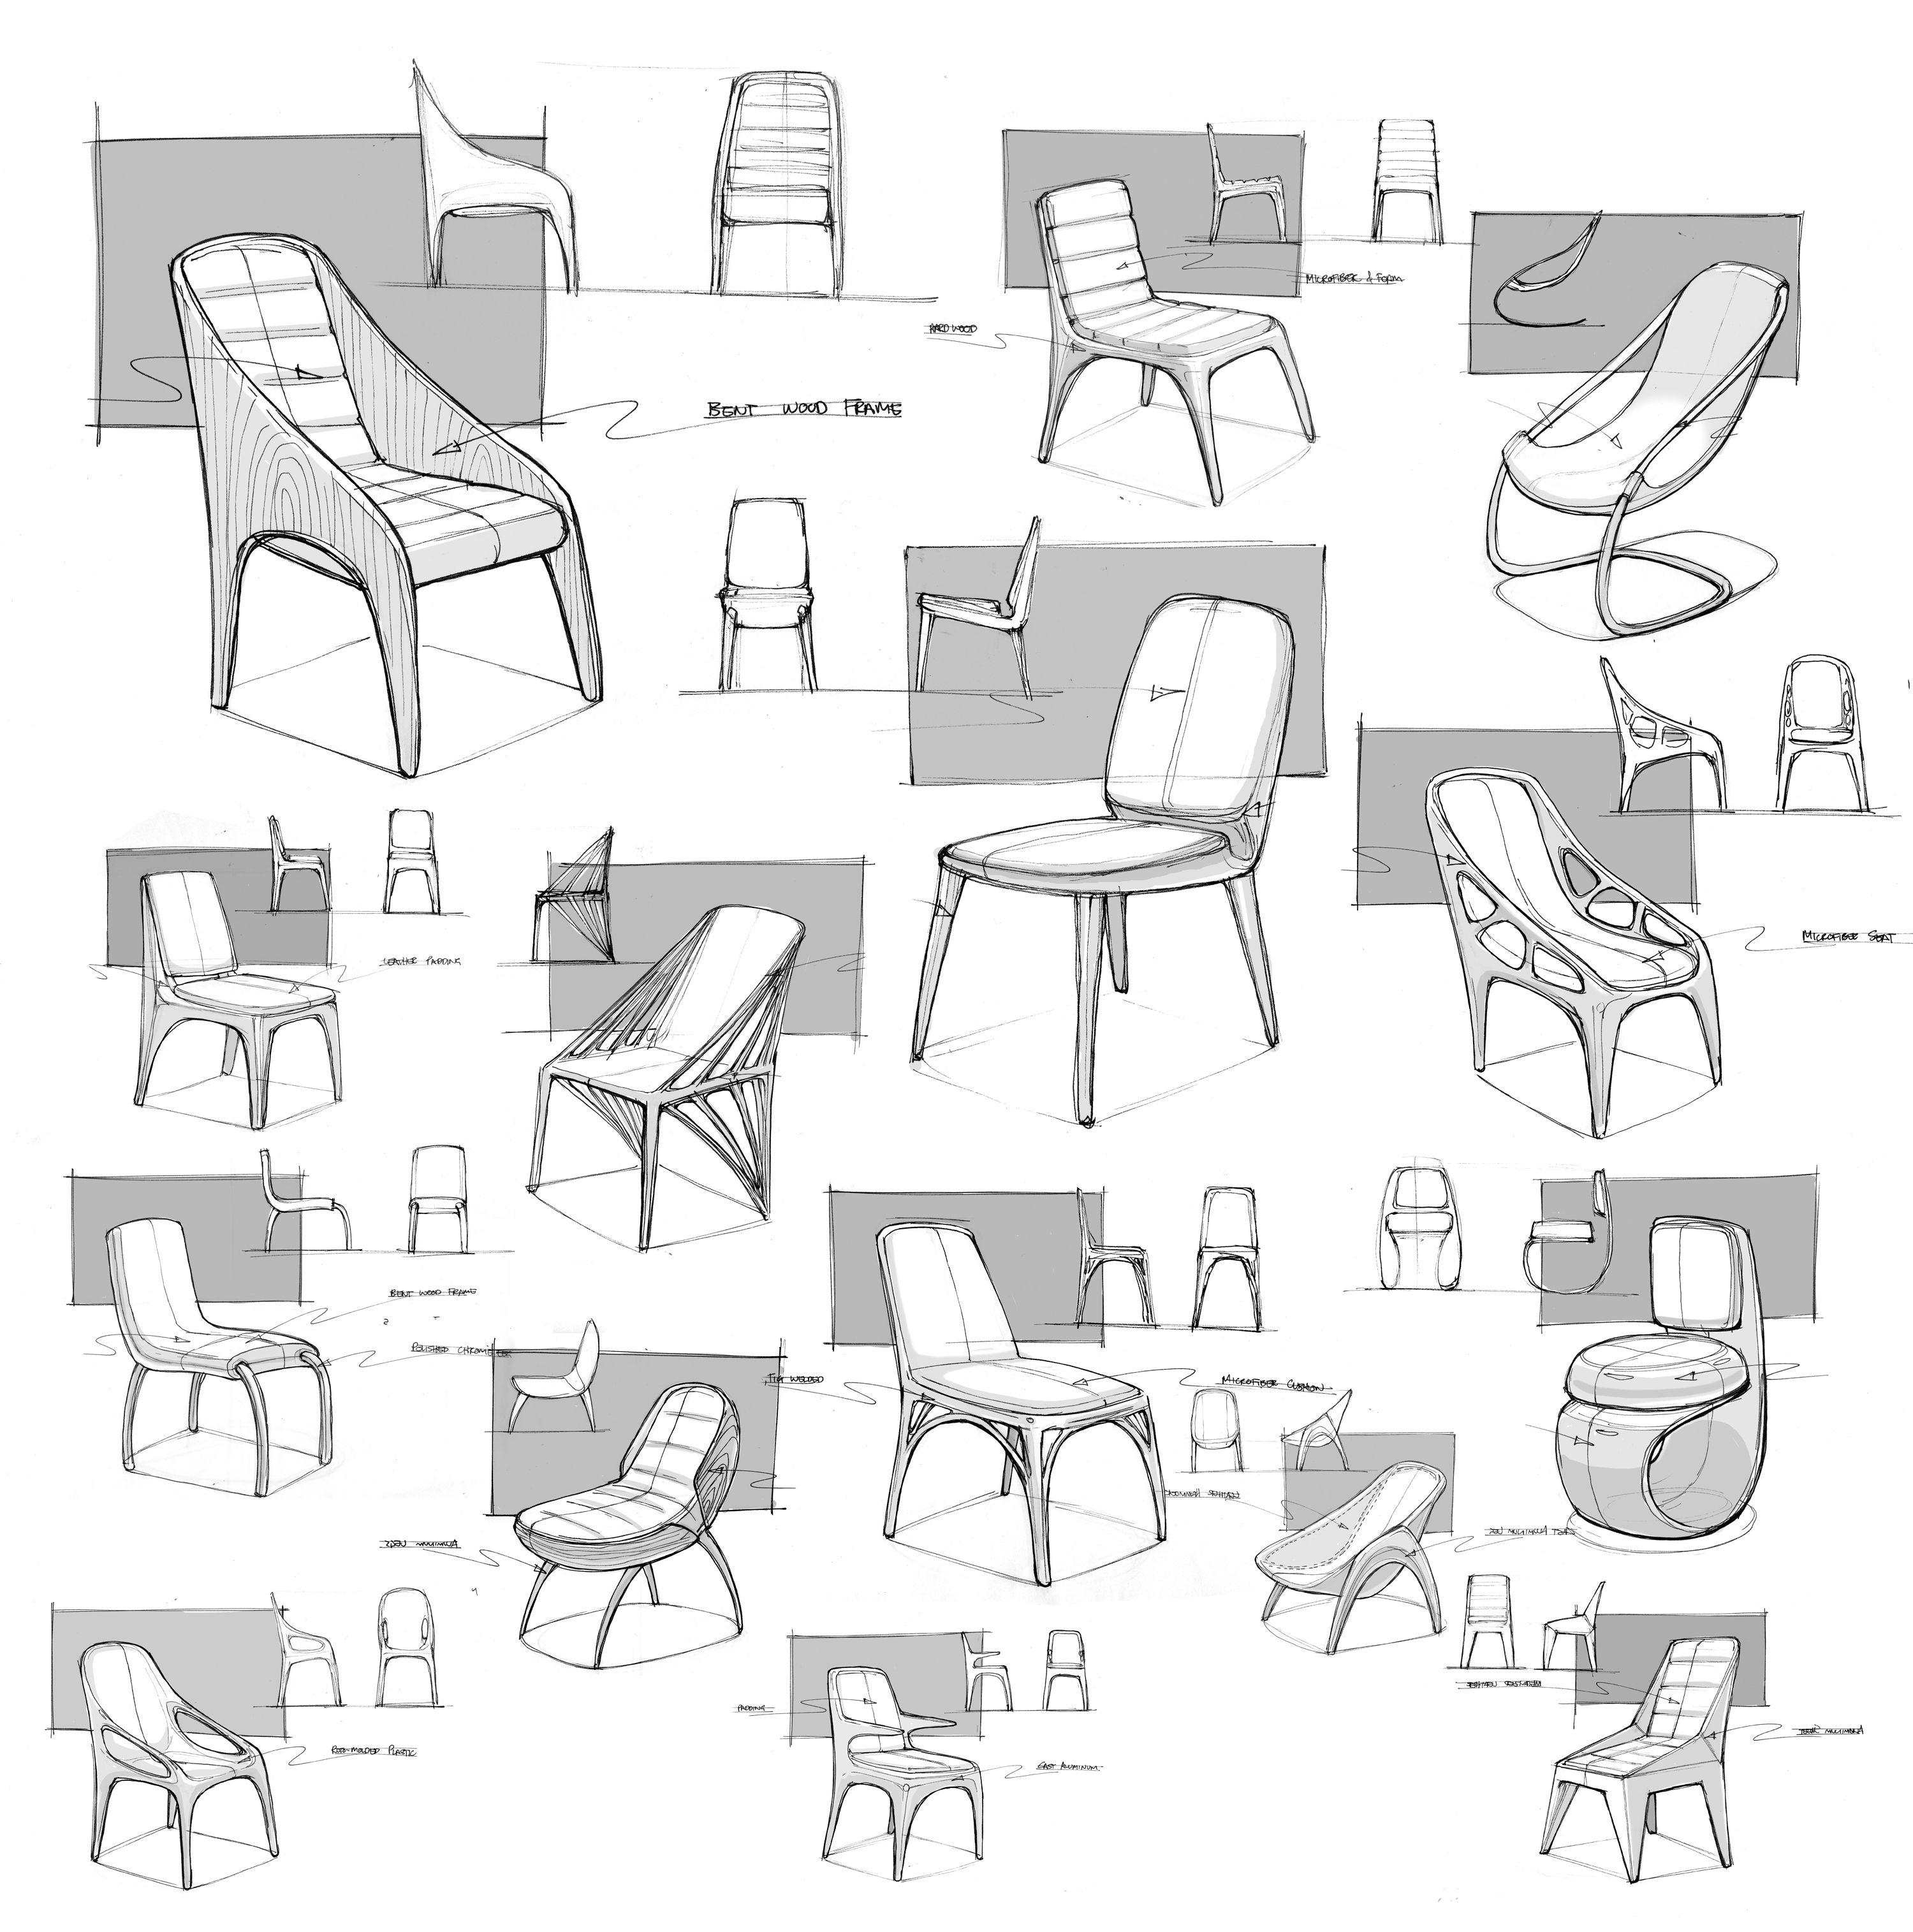
Design task:
TASK 2: Design a product
Create a design page of designs (at least 4) for a children’s chair influenced by the ‘POP ART’ art movement
Your design work must be presented on A3 paper, this can be hand designs only or a mixture of hand and CAD designs –show me your skills.

Slide 4
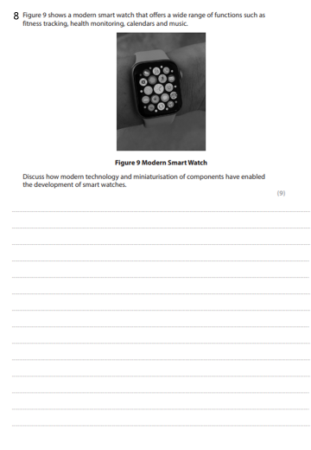
Exam question-

