Slide 1
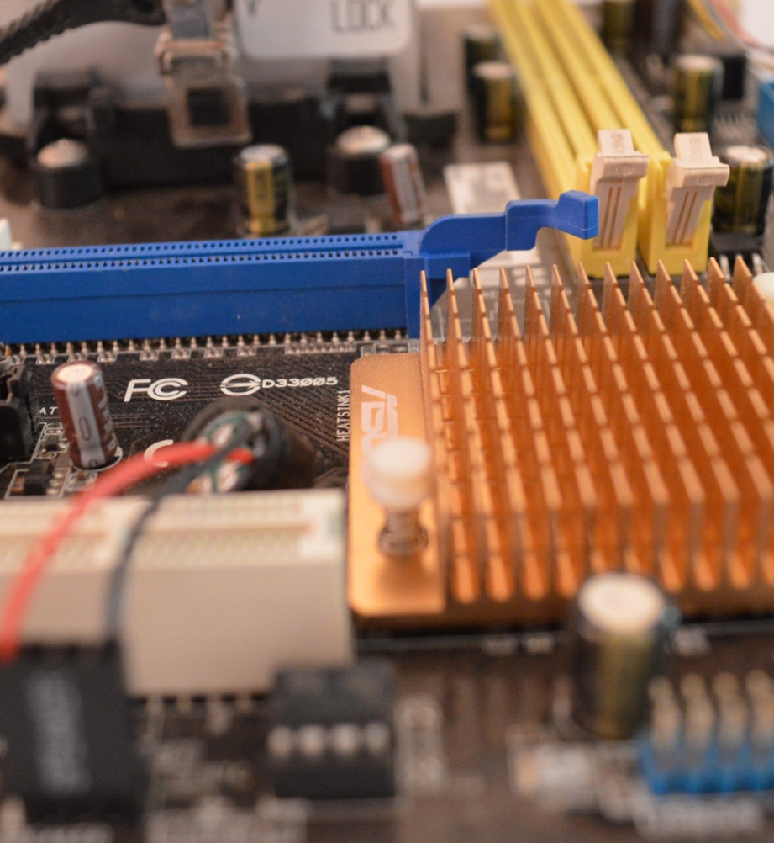
Computer Science
Transition workbook
Exam board: OCR
Assessment: 2 written exams (40% each exam) and a programming project (20%)
The topic of Computer Science is at the heart of the modern world
Studying it can make you extremely sought after in todays job market
The transition from GCSE to A level is significant, this includes:
  An increased emphasis on technical content
  An increased emphasis independent research
This workbook is designed to allow you to practice some of these skills and build on your existing knowledge.
Please complete by your first lesson back in September, sending digital copy to both DET and CHH (see emails below)
Name:
If you need any help or you have any questions about the transition work or the course please contact either:
chh@churchdownschool.com or det@churchdownschool.com

Slide 2
1
“Tell me about yourself”
Why did you choose Computer Science? What is the course about?
In this simple task you get the opportunity to tell me your choices and reasons behind choosing to study Computer Science. Please answer all questions as best you can.
1. Why did you choose to study A level Computer Science?
2. What other courses have you chosen to study at Key Stage 5, and what made you choose this combination?
3. What are you hoping to achieve from studying Computer Science?
4. How would you describe yourself as a learner at GCSE? What skills where you good at, what areas would you like to improve on?
5. What are your other hobbies and interests outside of school? Anything related to Computing?
6. How many external exams will you take as part of this course? How much of your final grade is the programming project worth?

Slide 3
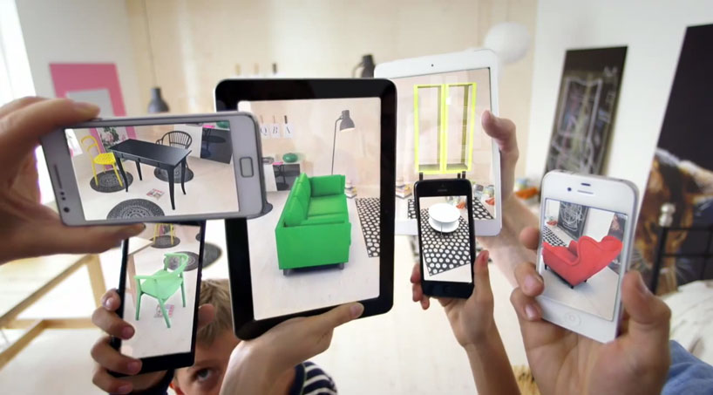
2
Independent research task
Emerging computer technology
In this task you get to investigate any area of emerging computer technology which interests you.
You can pick any area which interests you, but examples could be:
Artificial intelligence
Robotics
Automated self driving cars
Quantum computing
Augmented reality
In no more than ONE side of A4 summarise the area you have chosen under the following four headings:
What is it?
What are the possible Social, Moral, Cultural and Ethical benefits of this technology on society
What are the possible Social, Moral, Cultural and Ethical risks of this technology on society
My conclusion on this technology and what it will mean for our world 10 years from now
Additional help:
For additional help and support in structuring your answer you might like to watch some of the videos from the following Craig ‘n’ Dave playlists:
OCR:
SLR 17 – Ethical, morale and cultural issues
https://student.craigndave.org/videos/slr-17-ethical-moral-and-cultural-issues

Slide 4
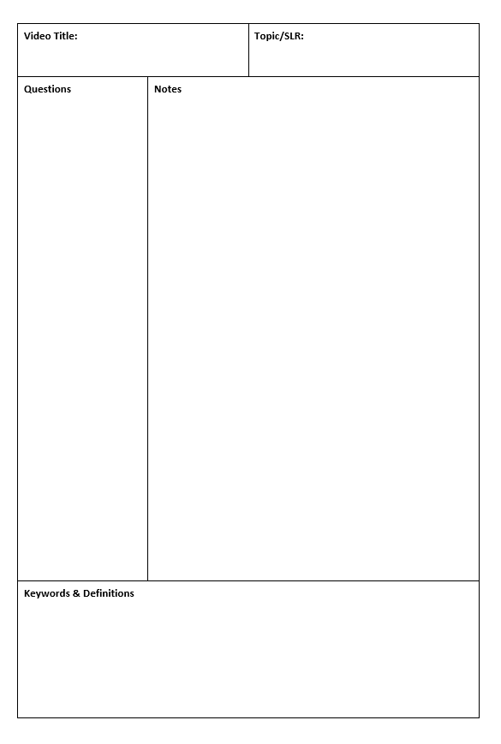
3
Note taking practice task
The Cornell method of note taking
The expectation to do independent research at A Level will increase dramatically from GCSE.
There is a real skill to taking decent notes outside of lesson which are of value. Research has proven that one of the most effective methods is the “Cornell” note taking method.
To start download the “Cornell note taking template” from Craig n Dave:
  https://craigndave.org/cornell-note-taking/
Watch the following two videos from Craig ‘n’ Dave:
  OCR: 3. OCR A Level (H406-H466) SLR1 – 1.1 Performance of the CPU - Craig 'n' Dave
  OCR: 32. OCR A Level (H446) SLR7 – 1.2 Programming paradigms - Craig 'n' Dave
Write the title of the video and its topic in the top boxes (use a different sheet for each video).
In the main “Notes” section, write notes from the video. You can do this in any way you like, a suggestion might be to rewind slightly when the canvas changes, thinking carefully about what was important in the previous few minutes.
Having recorded the notes, review them:
  Turn each part into a question in the section on the left.
  For example, the notes may say, “The value of the program counter is passed to the memory address register”.
  The question then becomes, “which register is the value of the program counter passed to?”
  Sometimes these questions are easy, and at times they are more difficult to write.
  There may also be more than one valid question.
  You will need to decide for yourself which are the most appropriate questions for revision.
Finally pull out all the key words and their definitions words the notes and list them in the bottom section.

Slide 5

4
Programming tasks – building confidence and recapping
Learning to “code” is a fun and essential part of A Level Computer Science. This task is a nice refresher ahead of starting your A Level course.
Head over to the web site: Summer Coding Challenges | Mission Encodeable
Complete the following Levels:
  • Level 1: Campfire story generator
  • Level 2: Which sea creature are you?
  • Level 3: Sandcastle smash
  • Level 4: Sun, sand, sea
Each section presents you with helpful guidance, instructions and hints to help you complete the tasks.
Please screenshot your code into the relevant sections below.
To help build up your skills ready for the A-Level course, it is would be recommended to complete levels 5-10 (if you do, please screenshot your programs on next slide)
Place Level 1 code here
Place Level 2 code here
Place Level 3 code here
Place Level 4 code here

Slide 6
4
Programming tasks – building confidence and recapping
Place Level 5 code here
Place Level 6 code here
Place Level 7 code here
Place Level 8 code here
Place Level 9 code here
Place Level 10 code here

Slide 7
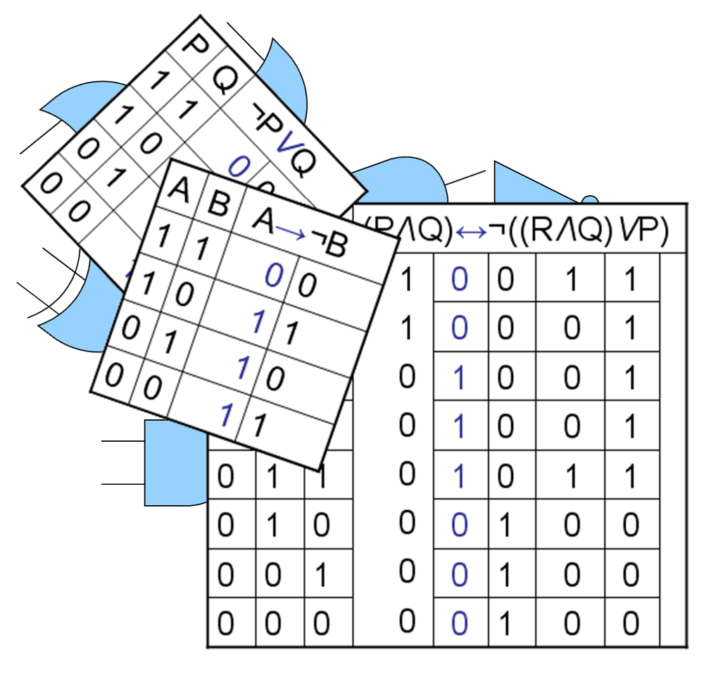
5
Computational logic task
Truth tables to circuit diagrams
An important area of computer science is understanding the logic gates and diagrams which are used to represent the physical circuitry of computer systems.
Carry out some research into the following areas:
Logic gates:
  AND
  NAND
  NOR
  NOT
  OR
  XOR
Truth tables
Boolean expressions
Circuit diagrams
Complete the tasks on the following slides.
Additional help:
For additional help and support in structuring your answer you might like to watch some of the videos from the following Craig ‘n’ Dave playlists:
OCR: SLR 15 – Boolean algebra
https://student.craigndave.org/videos/slr-15-boolean-algebra

Slide 8
5
Computational logic task
Truth tables to circuit diagrams
Drag the labels into their correct place on the following diagram:
OR
AND
XOR
NOT
NAND
NOR

Slide 9
5
Computational logic task
Truth tables to circuit diagrams
Draw the circuit diagram which would represent the following Boolean expression:
OCR Boolean Expression: F = ¬(¬C ∧ (A V B)
Complete the truth table for the circuit diagram you have drawn
A | B | C | D | E | F
0 | 0 | 0
0 | 0 | 1
0 | 1 | 0
0 | 1 | 1
1 | 0 | 0
1 | 0 | 1
1 | 1 | 0
1 | 1 | 1
A
B
F
C

Slide 10

6
Binary task
Representing negative numbers in binary
In GCSE computer science you will have learnt how to represent positive whole numbers in binary e.g. 47
At A Level you will need to know how to represent negative as well e.g. -47
Start to recapping (or learning if you didn’t do the GCSE) how to represent positive whole numbers between 0-255 in binary
Now research how to represent negative numbers in binary using the method known as:
Two’s complement
Complete the tasks on the following slides.
Additional help:
For additional help and support in structuring your answer you might like to watch some of the following videos from Craig ‘n’ Dave:
GCSE recap: How to represent positive binary values 0-255
https://student.craigndave.org/videos/aqa-gcse-slr13-number-bases
A Level: Representing negative binary values using Two’s Complement
https://student.craigndave.org/videos/aqa-alevel-slr11-twos-complement

Slide 11
6
Binary task
Representing negative numbers in binary
Write out the positive binary number 107, the answer should be displayed in 8 bits.
How would you represent the lowest negative number possible using Two’s Complement, given 8 bits.
128 | 64 | 32 | 16 | 8 | 4 | 2 | 1
Binary weighting
Binary weighting
Binary value
Binary value
Write out the negative binary number -107 using Two’s Complement, the answer should be displayed in 8 bits.
How would you represent the largest positive number possible using Two’s Complement, given 8 bits.
Binary weighting
Binary weighting
Binary value
Binary value

Slide 12
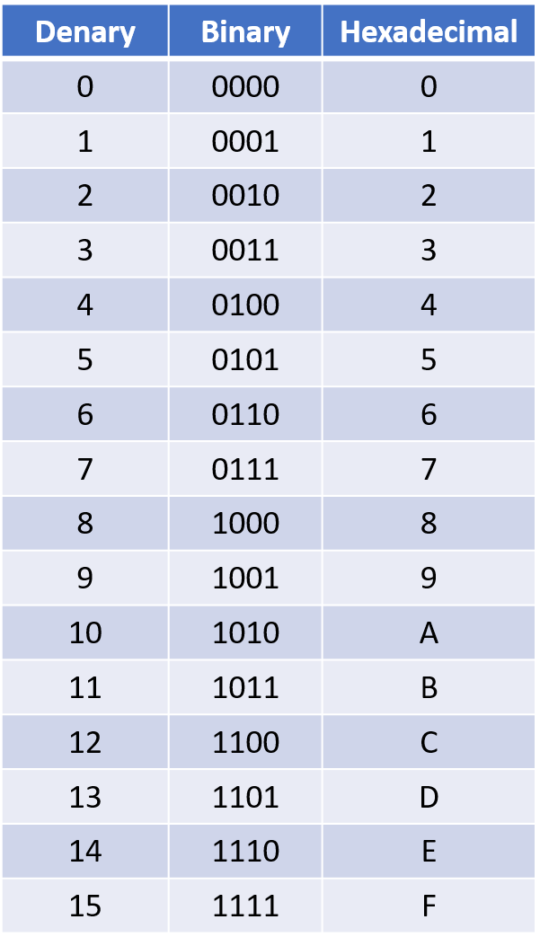
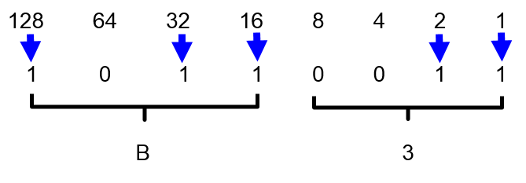
16
Binary task
Converting between base-2, base-10 and base-16
Expected time to complete: 1½ hours
As humans we have use the decimal or denary number system (base-10), made up of the unique digits 0-9.
Computer systems at the most basic level use only binary 1’s and 0’s (base-2).
As a computer scientist you will also need to become familiar with the hexadecimal number system (base-16).
You will also need to be comfortable with converting numbers between these three base systems.
Research the following areas:
Base-2 binary number system
Base-10 decimal/denary number system
Base-16 hexadecimal number system
How to convert between base-2, base-10 and base-16
Complete the tasks on the following slides.
Additional help:
For additional help and support in structuring your answer you might like to watch some of the following videos from Craig ‘n’ Dave:
Base 2, 10 and 16 number systems:
https://student.craigndave.org/videos/aqa-alevel-slr10-base-2-10-and-16-number-systems
Converting between binary, hex and decimal:
https://student.craigndave.org/videos/aqa-alevel-slr11-aqa-converting-between-binary-hex-and-decimal

Slide 13
6
Binary task
Converting between base-2, base-10 and base-16
Expected time to complete: 1½ hours
Convert the base-2 binary number 11000101 into base-10 and base-16.
(Show all your working)
Convert the base-16 hexadecimal number 9F into base-2 and base-10.
(Show all your working)
You may wish to cut and paste this standard binary weighting line to help lay out parts of your answer
128 | 64 | 32 | 16 | 8 | 4 | 2 | 1
Binary weighting
Binary value

